Slide 1
Intro to Machine Learning Concepts

Slide 2
Intro to Machine Learning Concepts
Title Slide
Introduction to Machine Learning
Understanding Models in ML
Learning in Machine Learning
Components of a Learning Process
Generalization in Machine Learning
Evaluation of Models
Why Use Machine Learning?
Types of Machine Learning
Challenges in Machine Learning

Slide 3
Intro to Machine Learning Concepts
Addressing ML Challenges
Conclusion

Slide 4
Introduction to Machine Learning
Key Definition: Machine learning is a facet of AI that facilitates automated learning from data inputs.
Main Components: Data, algorithms, and models form the foundational pillars integral to machine learning processes.
Pattern Recognition: ML excels in identifying data patterns, enhancing predictive accuracy through experience over time.

Slide 5
Understanding Models in ML
Model Definition: A model mathematically represents relationships in data, transforming input variables into output predictions.
Linear Regression Example: In linear regression, the model's equation y = mx + b is derived from training data patterns.
Training Process: The training involves adjusting parameters m and b to minimize prediction errors based on historical data.

Slide 6

Learning in Machine Learning
Experience in ML: Experience refers to data exposure that systems utilize for learning, forming the basis of performance.
Task Clarification: The task defines the specific problem each model aims to solve, guiding its learning and evaluation.
Performance Measurement: Performance employs metrics like accuracy or precision to assess how well models execute defined tasks.
Generated on aidocmaker.com

Slide 7
Components of a Learning Process
Data Storage Importance: Data storage is crucial for organizing diverse datasets, enabling effective training and validation of models.
Abstraction Techniques: Abstraction simplifies data through feature extraction and dimensionality reduction, enhancing model efficiency in learning.
Relational Database Example: Relational databases store structured data essential for systems like recommendation engines enabling personalized suggestions.

Slide 8
Generalization in Machine Learning
Generalization Importance: Models must accurately predict unseen data, improving their robustness and applicability in real-world scenarios.
Overfitting Explained: Overfitting occurs when models memorize training data, leading to poor performance on new, unseen inputs.
Bias-Variance Trade-Off: Balancing model complexity against generalization is critical; low bias and variance enhance predictive accuracy.

Slide 9

Evaluation of Models
Performance Metrics Overview: Key metrics include accuracy, precision, recall, and RMSE, crucial for model evaluation effectiveness.
Confusion Matrix Utility: A confusion matrix visualizes classification performance by displaying true vs. predicted outcomes distinctly.
Cross-Validation Technique: Cross-validation enhances model comparison reliability by assessing performance across multiple training/testing splits.
Generated on aidocmaker.com

Slide 10
Why Use Machine Learning?
Adaptability Over Rigidity: Machine learning models evolve with new data, contrasting traditional systems which require manual rule updates.
Complexity Handling: ML efficiently addresses intricate patterns that are challenging for static rules-based programming to manage.
Real-Time Predictions: Machine learning enables instant predictions, enhancing responsiveness in applications like spam filtering and image recognition.

Slide 11
Types of Machine Learning
Supervised Learning: In supervised learning, models predict output labels from labeled datasets, used in classification tasks.
Unsupervised Learning: Unsupervised learning identifies underlying patterns in data without labels, useful for clustering applications.
Reinforcement Learning: Reinforcement learning incentivizes decision-making through rewards, applied in robotics and game-playing scenarios.

Slide 12
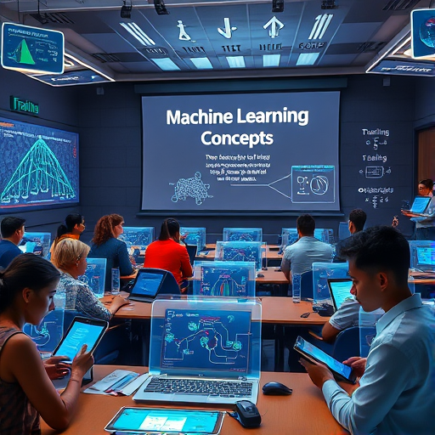
Challenges in Machine Learning
Data Quality Issues: Insufficient or poor quality data, including noise and missing values, adversely affects model training.
Algorithmic Complexity: Challenges like overfitting and interpretability hinder understanding model decisions and generalization capabilities.
Ethical Considerations: Bias in data and algorithms raises fairness concerns that necessitate careful evaluation and management.
Generated on aidocmaker.com

Slide 13
Addressing ML Challenges
Data Preprocessing Techniques: Employ data preprocessing and augmentation to improve model performance through cleaned and enriched datasets.
Regularization Methods: Implement regularization techniques to prevent overfitting, ensuring models generalize well beyond training data.
Cloud Infrastructure Utilization: Leverage scalable cloud infrastructure for efficient model training and deployment, optimizing computational resource use.

Slide 14
Conclusion
Transformative Potential: Machine learning revolutionizes decision-making and operational efficiencies across diverse sectors with its adaptability.
Responsible Use Emphasis: Ethical considerations must guide machine learning applications, ensuring fairness and bias mitigation in implementations.
Addressing Challenges Proactively: To maximize effective outcomes, ethical and technical challenges inherent in ML must be systematically tackled.

